Slide 1
RightInfo
Reporting digital disinformation in Africa
Road2DevCon Hackathon
Consensys Labs Relay Bounty:
ReInventing the Online News Economy

Slide 2
Preview
The exposure of citizens to large scale disinformation, including misleading or outright false information, is a major challenge for Africa.
Disinformation is verifiably false or misleading information created, presented and disseminated for economic gain or to intentionally deceive the public. It may have far-reaching consequences, cause public harm, be a threat to democratic political and policy-making processes, and may even put the protection of citizens' health, security and their environment at risk.
Disinformation erodes trust in institutions and in digital and traditional media and harms our democracies by hampering the ability of citizens to take informed decisions. It can polarise debates, create or deepen tensions in society and undermine electoral systems.
Fighting disinformation in the era of social media and online platforms has to be a coordinated effort involving all relevant actors, from institutions to social platforms, from news media to single users.
Source: Digital Single Market

Slide 3

The Problem - Please watch……
See articles that published these examples talked about on slide 10, points 1,2, 3

Slide 4
How can blockchain solve the problem of digital disinformation? How do we ensure users access more original content on the internet? How do we keep track of defaulters and articles? How are reporters incentivized? Is it sustainable?

Slide 5

Meet Zulu.
A South African, he’s part of a research community mandated by the government to monitor online content for traces of disinformation.
He’s confused on how his team would go about the task, and what the penalty would be for defaulters.

Slide 6

Meet Joy.
A Nigerian blogger, passionate about her country and hates it when it’s portrayed in a bad light.
She’s concerned at the rate disinformation is spread by politicians during elections in the country, and would love a solution that can track defaulters and reward reporters like her.

Slide 7

The government is banking on Zulu and his team to provide a solution to save the country from social media slander, they’re also willing to support the team in crypto.
Source: Electoral commission of South Africa

Slide 8
Then, Joy discovered RightInfo
She found out she could just install the RightInfo extension on her browser and when she comes across a disinforming article/content she could quickly report it using the rightinfo extension.
Joy loves this solution because she can also access a directory of reported urls using the extension, to search for urls of fake news articles to beware of.

Slide 9
Real Life Occurrences of Disinformation in Africa
https://www.pulse.ng/news/local/fact-checking-is-there-a-buhari-double-or-clone/163elct
https://www.wsj.com/articles/on-the-issue-of-whether-ive-been-cloned-an-election-gets-weird-1544459732
https://dubawa.org/old-picture-used-to-portray-buhari-arriving-his-polling-unit-after-election-postponement/
https://techcrunch.com/2019/05/20/facebook-account-purge-africa-fake-news/
https://medium.com/dfrlab/inauthentic-israeli-facebook-assets-target-the-world-281ad7254264
https://www.bbc.com/news/world-africa-44137769
https://www.voanews.com/africa/nigeria-battle-against-fake-news-ahead-elections
https://medium.com/positive-returns/reducing-the-spread-of-misinformation-in-africa-b88c3fb0c46

Slide 10
In Nigeria where almost 19% of people are jobless, employment scams make up 6.2% of fake news stories shared in WhatsApp.
Roughly 3% of fake news circulated on WhatsApp concerns terrorism and the army, mirroring Nigerians' anxieties about instability and uncertainty caused by Islamist militants among other things.
Scams related to money and technology contribute to about a third of the fake news stories shared in Kenyans' WhatsApp conversations. Religion accounts for roughly 8%, researchers found.
Source: BBC

Slide 11

RightInfo is a blockchain application geared towards enabling easy reporting & tracking of disinformation content on the web.

Slide 12




How RightInfo works...
Download & Install the RightInfo extension from any web store
Navigate to read article on browser
Click on Rightinfo at the top right-hand corner of browser to report article using the dropdown options
Reported urls sent to a directory stored on the blockchain for upvotes on authenticity

Slide 13
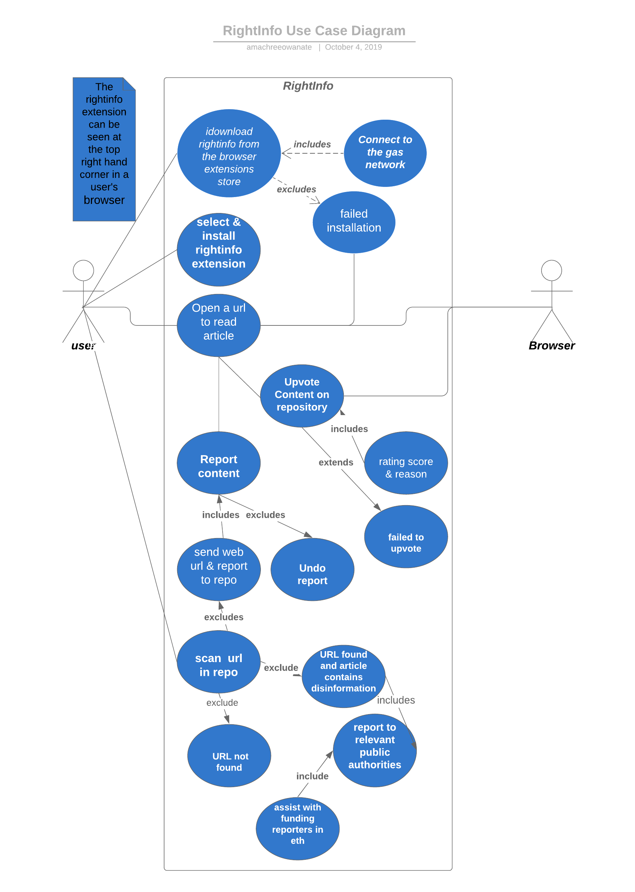
UML Use Case

Slide 14
It’s no surprise Joy and Zulu uses RightInfo on their site regularly to report disinformation .
Product Demo

Slide 15
Why Blockchain?
Transparency in the article
Blockchain will solve the problem of transparency through the online repository of article urls, users can view the source of the content and will determine its authenticity.
Decentralization
The ability to report doesn’t depend on one body, everyone has a fair chance of reporting disinformed articles and gets paid when the sources are verified.
Immutability
Unknown bodies can’t tamper with the repository seeing as it is stored on the chain.

Slide 16
The Code of Practice on disinformation is the first worldwide self-regulatory set of standards to fight disinformation voluntarily signed by platforms, leading social networks, advertisers and advertising industry in October 2018. Signatories of the Code presented detailed roadmaps to take action in 5 areas:
Disrupting advertising revenues of certain accounts and websites that spread disinformation
Making political advertising and issue based advertising more transparent
Addressing the issue of fake accounts and online bots
Empowering consumers to report disinformation and access different news sources, while improving the visibility and findability of authoritative content
Empowering the research community to monitor online disinformation through privacy-compliant access to the platforms' data.
Regulations

Slide 17



The Team
Brian Siphamandla
Owanate Amachree
Badara Diakhate
Blockchain Developer
Backend Developer and Technical Writer
Blockchain Developer

Slide 18

About RightInfo
Enables users to report disinformation on any article or content through an extension embedded into their browsers connected to web3.
Also gives enables users view a directory containing list of misinformed articles url sent via the extension and stored on the blockchain for easy tracking, thereby cleaning up the web so users have access to more original content..
Incentivizes users to report disinformation through funding from the public and public institutions..

